Slide 1
BlockChain ATM
Agenda:
Current ATM Networking VS BlockChain ATM Networking
Innovation Benefit
System Architecture
Transaction Flow Demonstration
Innovation Essentials
System Features, Environments, Technologies, and Tools
Roadmap

Slide 2











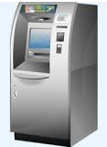
Current ATMs Routing via VISA, Mastercard and UnionPay
……

Slide 3




Future ATMs Directly Connected via BlockChain

Slide 4





Innovation Benefit
3rd party association cost saved, pure bank-to-bank communication (90% surcharge per transaction can be saved)
No customer information exchange with 3rd party, all customer information protected in bank
No server down time, real 7 X 24
Never can transaction record be changed
No fake transaction can be accepted in BlockChain, even hackers attempt to
The architecture can be easily extended to other inter-bank system, e.g., transfer, payment, capital exchange etc.

Slide 5
Innovation Benefit – Share 3rd Party’s Service Revenues
- Data processing revenues, and international transaction revenues
Millions USD

Slide 6
System Architecture
Bank A
Blockchain
Bank C
Bank B

Slide 7
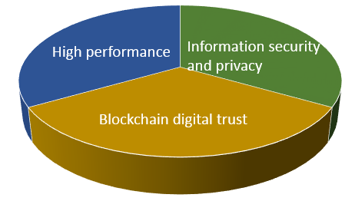
Innovation Essentials
Digital trust without reliance on an external authority This is the core benefit of blockchain, which is provable and intrinsic to the system. In our system, blockchain plays 2 key roles:
Cross bank transaction routing
Clearing
Information security and privacy – our system achieves them by:
Network permissioning - only permissioned nodes can be added to the bank consortium chain.
Separate customer information with inter bank clearing information: customer information is encrypted by bank public key, it can only be decrypted by bank backend system with private key. Any nodes in the blockchain is unable to decrypt customer information.
High performance:
With no need for POW/POS in a permissioned network, we use multiple consensus mechanisms that are more appropriate for consortium chain such as Raft-based Consensus, it ensure millisecond-level blocktimes, much faster than vanilla Bitcoin or Ethereum blocktimes.

Slide 8
System Features
Cross bank cash withdrawal / balance enquiry / cash deposit / transfer transactions
Data flow demonstration
Store customer information (account, password, balances etc.) in bank backend
Store cross bank transaction information (transaction ATM / debit bank / credit bank / amount / fee) to blockchain
Blockchain network status monitoring
Blockchain accounts and balances retrieval
Blockchain transaction records retrieval
Customer transaction records retrieval (from bank backend)
Cross bank clearing and reconciliation

Slide 9
Environments, Technologies and Tools
Environment and Technologies:
Blockchain:
Ethereum (Go-etherum, Web3JS, Solidity)
Quorum -- an open-source Ethereum-based distributed ledger protocol with transaction/contract privacy and new consensus mechanisms by JPMorgan Chase
Raft consensus -- a consensus model for faster blocktimes, transaction finality, and on-demand block creation
Our system runs on 5 Aliyun cloud servers
CentOS and Ubuntu Linux
Node.js, Tomcat, MySQL
AngularJS, Java, JQuery, Websocket, Bootstrap…
Our GitHub page: https://github.com/yifon/SST_BlockChain Can find our system design, source code, wiki, issues etc. there

Slide 10
Roadmap
ATM network is naturally suitable for blockchain technology as they have physical presences in different areas across countries, they need a trusted association to connect. Major inter-bank associations were developed by providing cross border ATM network connections. It’s time to transfer the ‘agent’ role from big expensive enterprise to digital.
However due to various regulatory constraints, different banks’ business strategies and interests, such transformation or replacement is very challenging. It should be achieved step by step, from the innovative parties internally. Here is the proposed roadmap:
Different entities,
same group,
Cross countries
Different entities,
same group,
same country
Different banks,
Cross countries
Different banks in limited areas,
Same country

